Slide 1
Polynomials and FFT

Slide 2
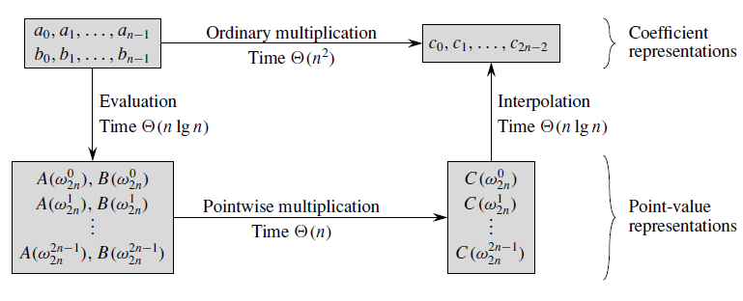
Efficient Polynomial Multiplications

Slide 3
Working of FFT
1. Double degree-bound: Create coefficient representations of A(x) and B(x) as degree-bound 2n polynomials by adding n high-order zero coefficients to each.
2. Evaluate: Compute point-value representations of A(x) and B(x) of length 2n through two applications of the FFT of order 2n. These representations contain the values of the two polynomials at the (2n)th roots of unity.
3. Point wise multiply: Compute a point-value representation for the polynomial C(x) = A(x)B(x) by multiplying these values together point wise. This representation contains the value of C(x) at each (2n)th root of unity.
4. Interpolate: Create the coefficient representation of the polynomial C(x) through a single application of an FFT on 2n point-value pairs to compute the inverse DFT.
Steps (1) and (3) take time (n), and steps (2) and (4) take time (n lg n).

Slide 4
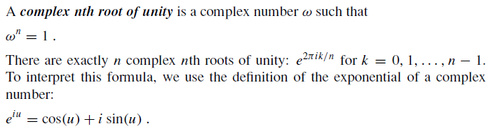
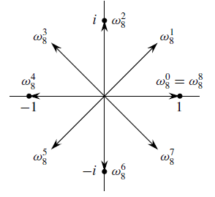
Complex roots of unity

Slide 5
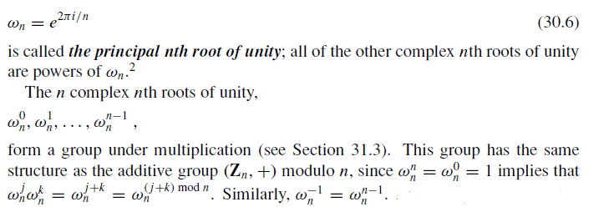
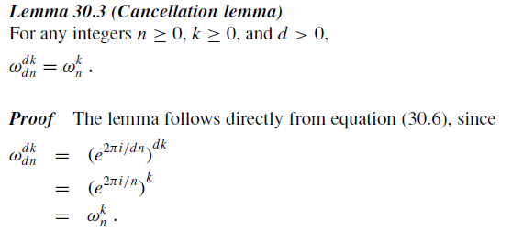
Complex roots of unity

Slide 6
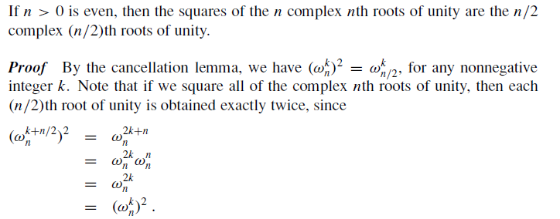
Halving lemma of Complex roots of unity

Slide 7
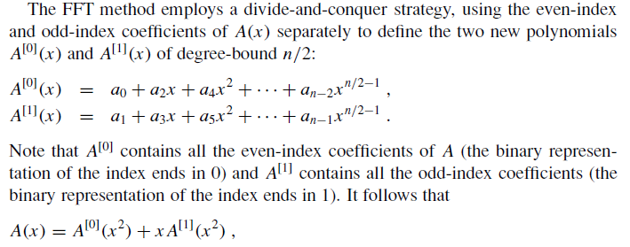
Fast Fourier Transform

Slide 8
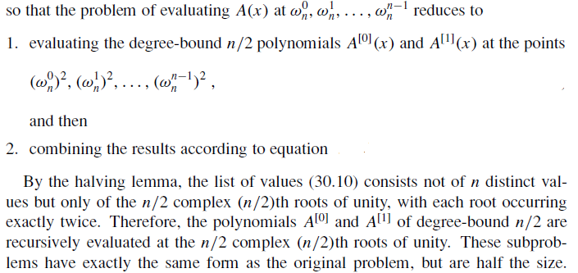
Fast Fourier Transform

Slide 9
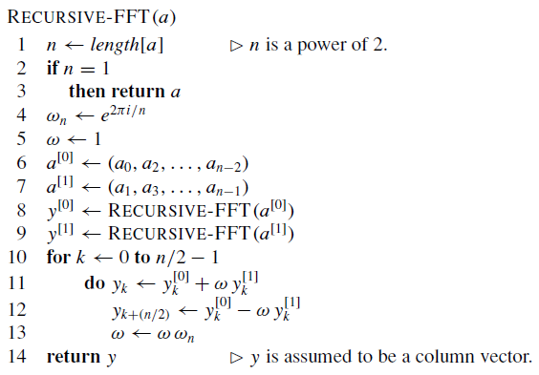
Fast Fourier Transform

